Slide 1


CS604 Deep Learning StyleGAN: State of the Art Face Morphing
Group 8
Chia Kai Leng
Chia Yong Qing
Heber Ng Ka Chun
Lee Meng Yong

Slide 2

Examples of StyleGAN
Web Showcase
01
03
What is StyleGAN?
Challenges
02
04
Agenda
StyleGAN
Demonstration of project.
Science behind the Machine Learning framework.
Sharing on project limitations and future work.

Slide 3
Examples of StyleGAN

Slide 4

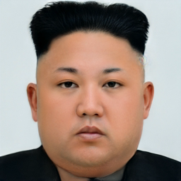

Examples of StyleGAN
Happy Kim
Baby Kim
* All images/videos created by us

Slide 5
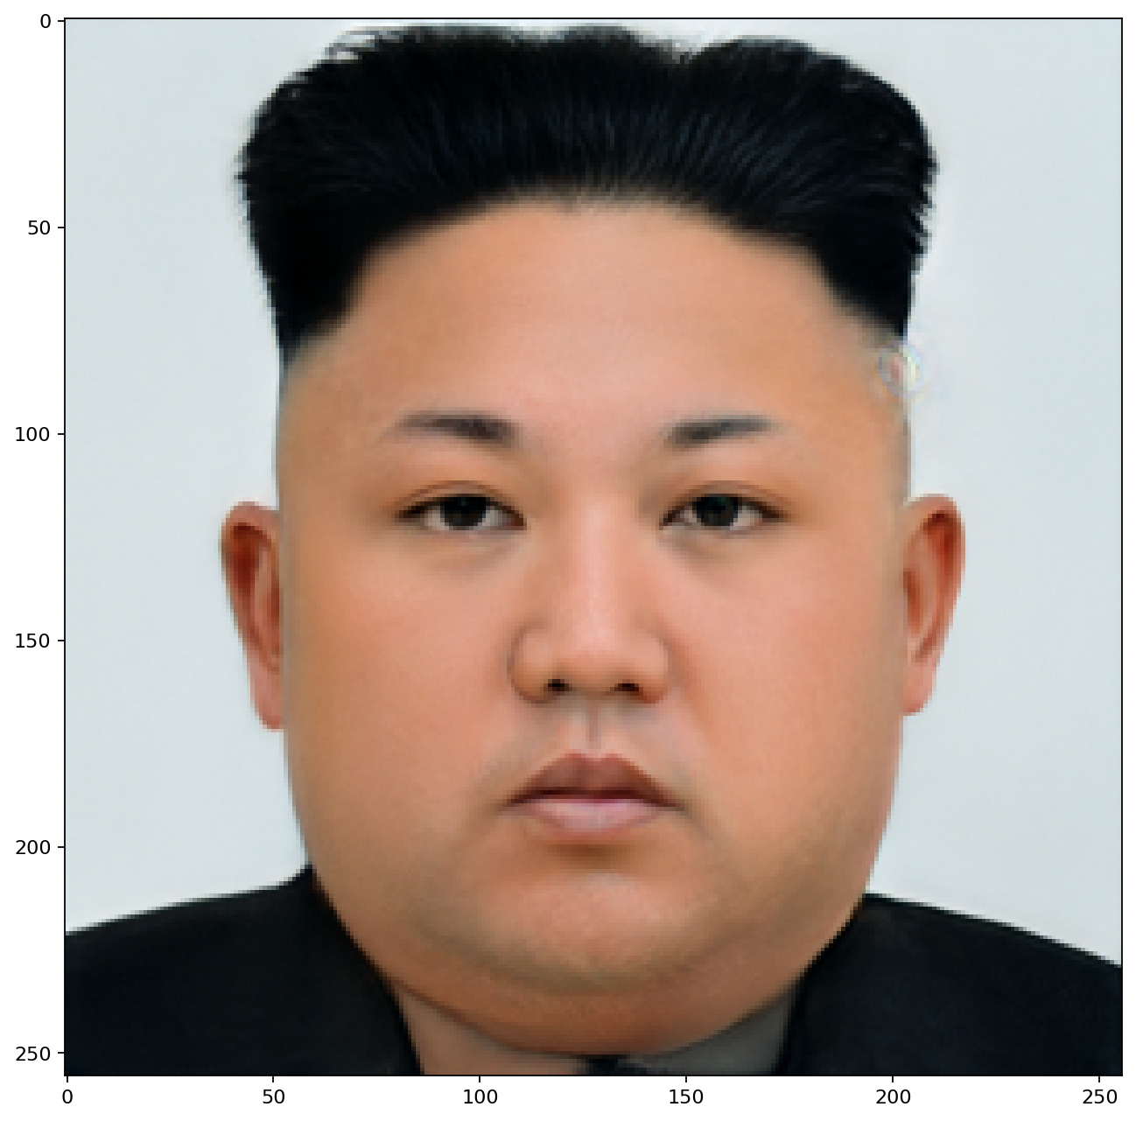
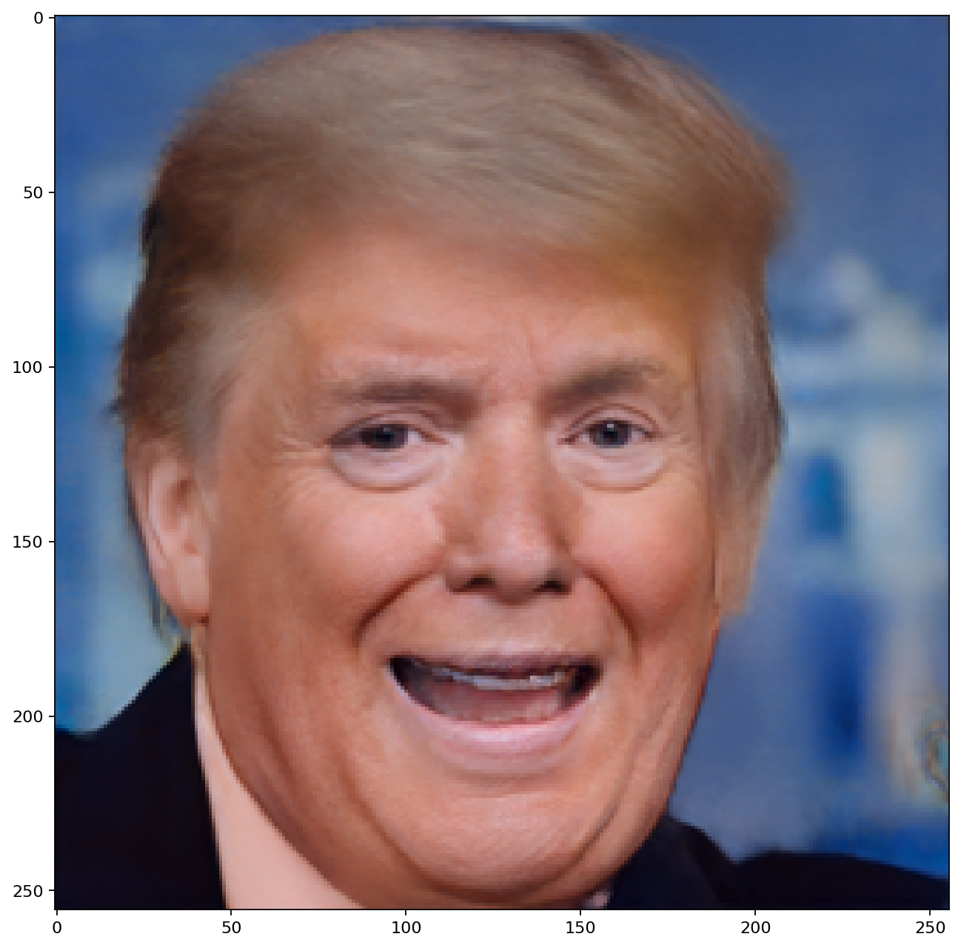
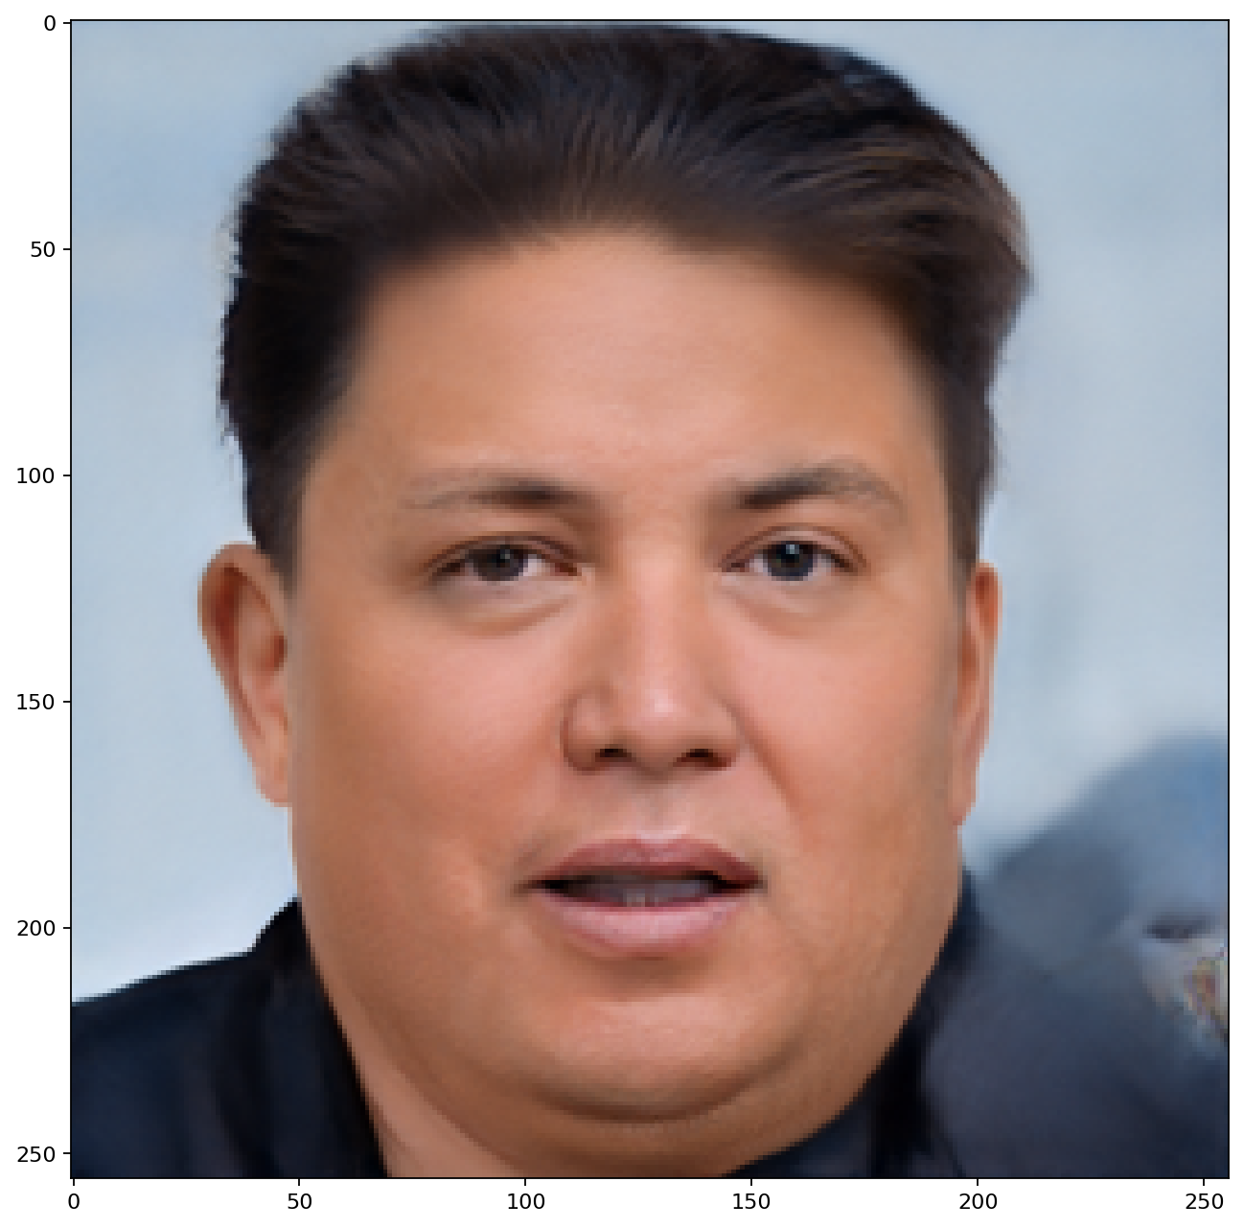
Examples of StyleGAN
+
=
Kim
Trump
Most powerful person
in the world?
* All images/videos created by us

Slide 6
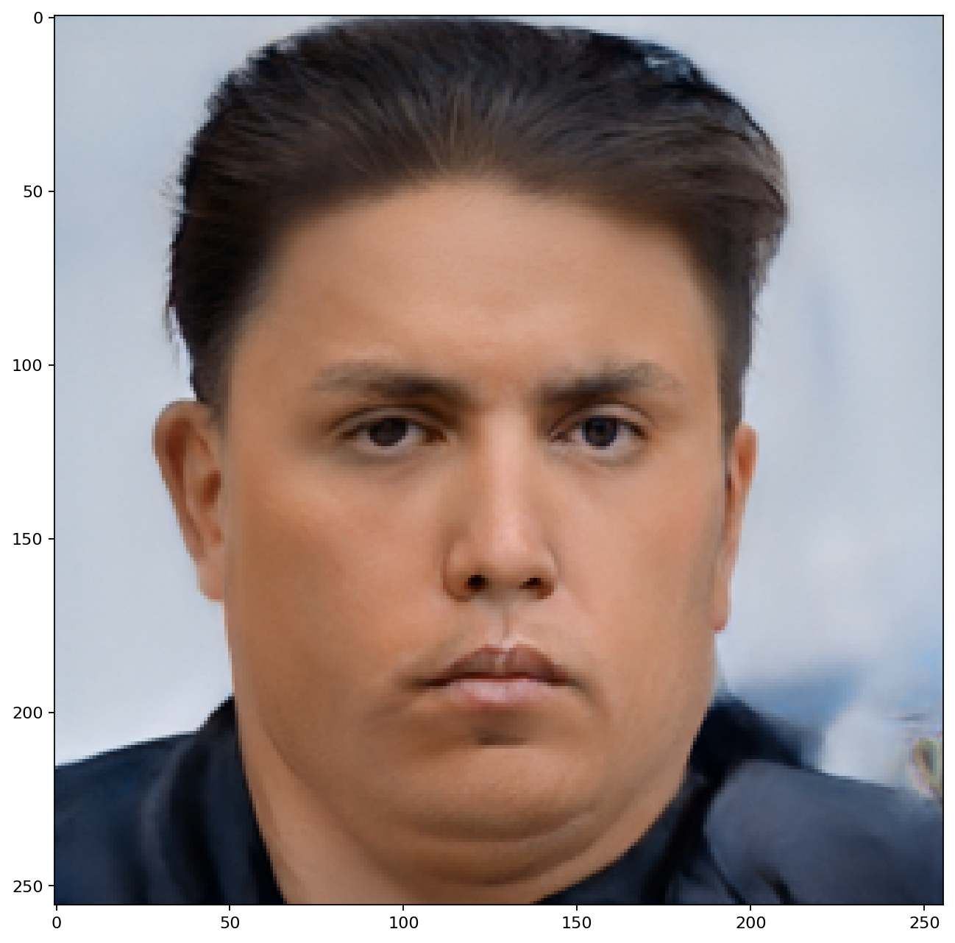
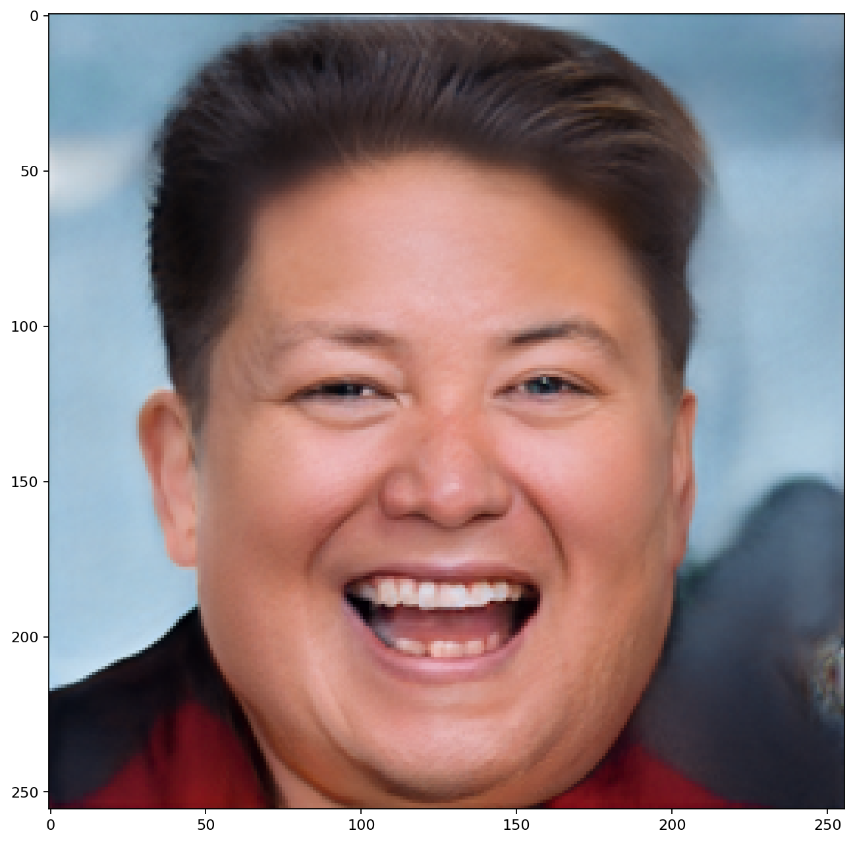
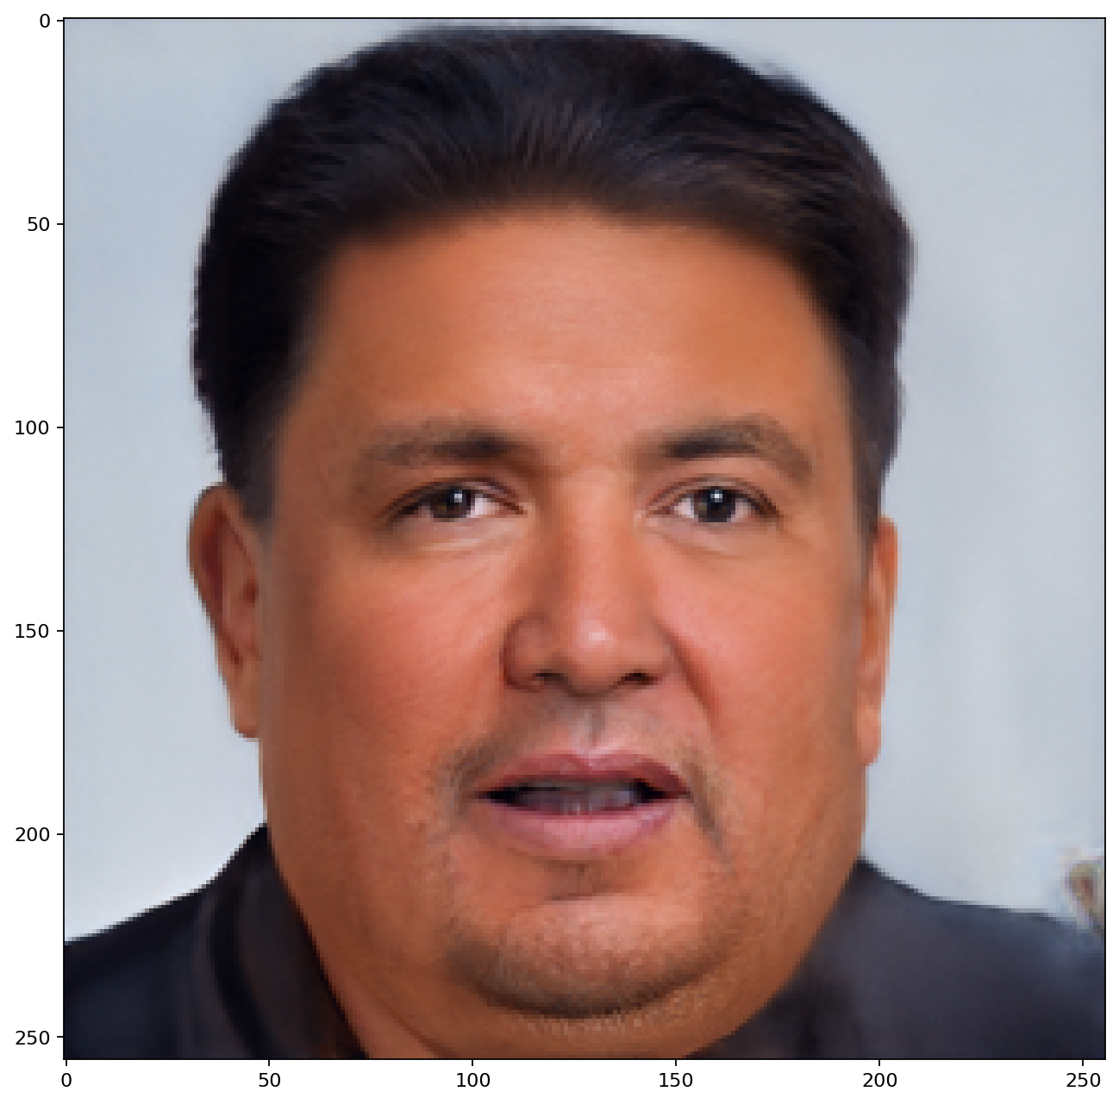
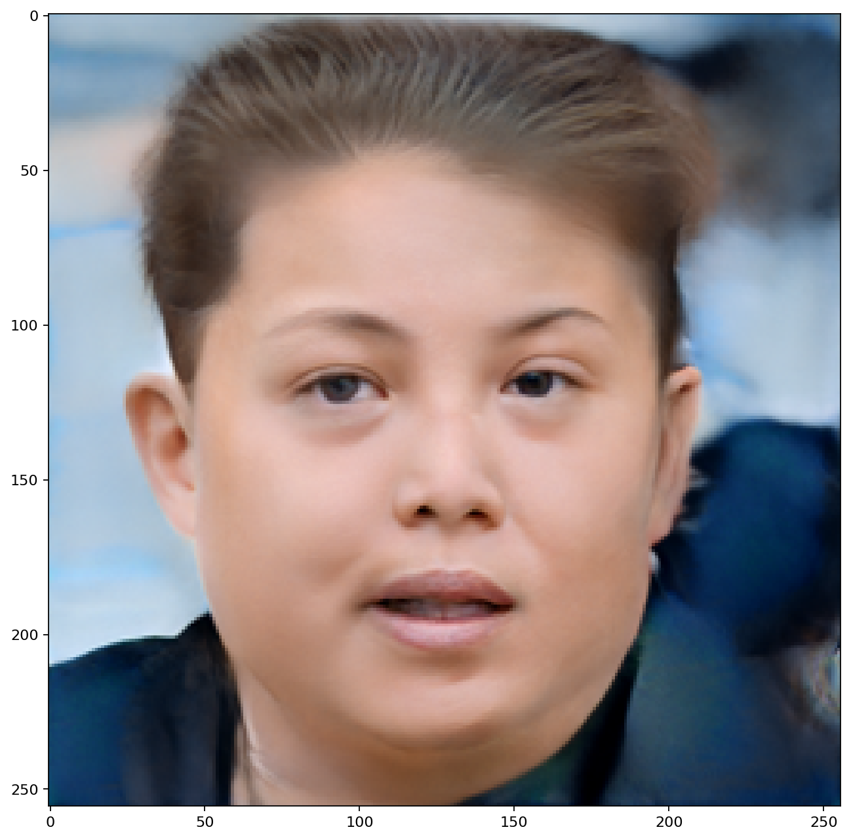
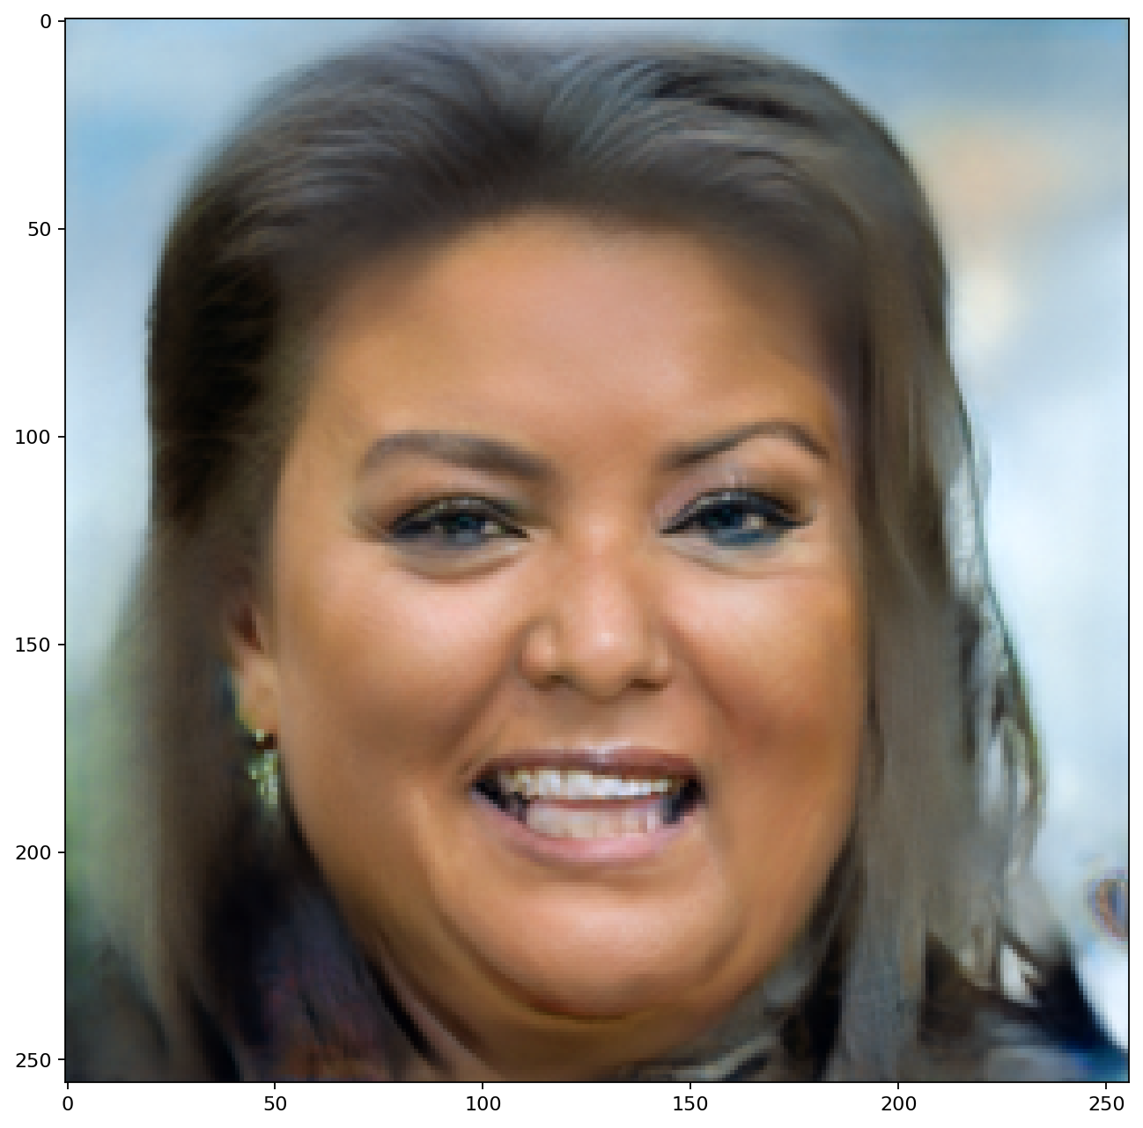
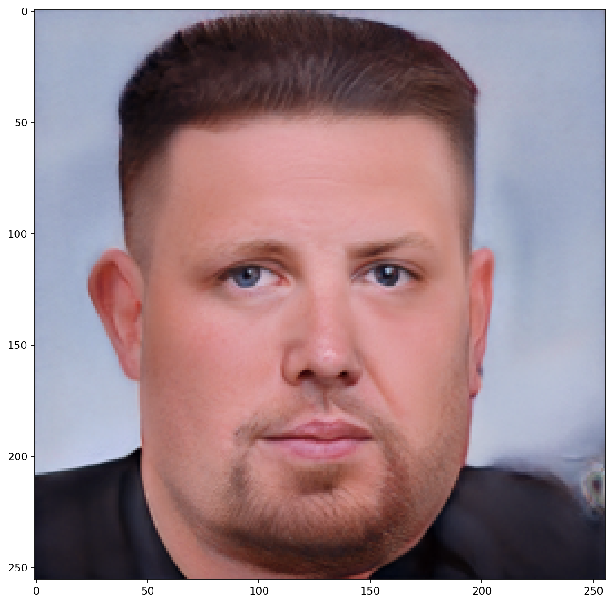
Examples of StyleGAN
Frown
Smile
Older
Younger
Most powerful person
in the world?
Feminine
Manlier
* All images/videos created by us

Slide 7
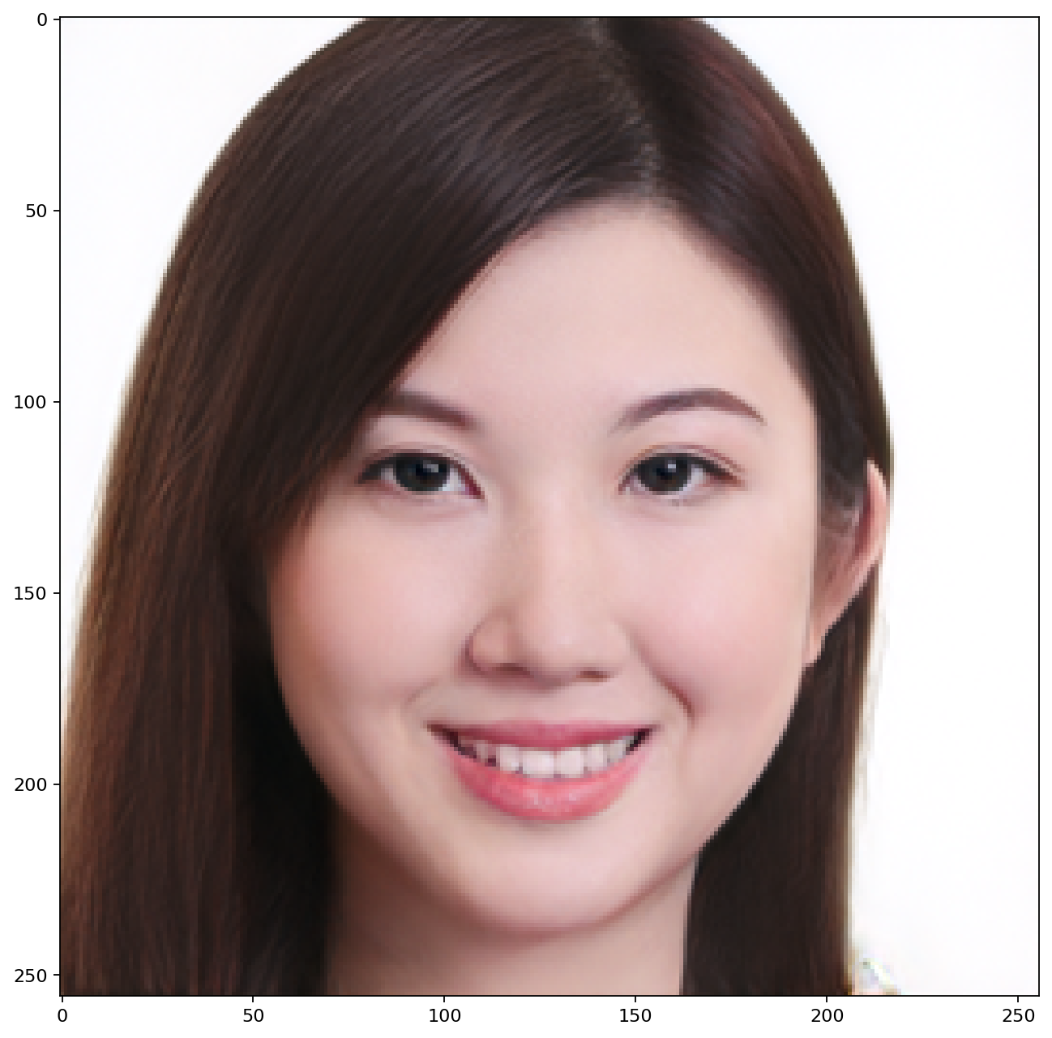
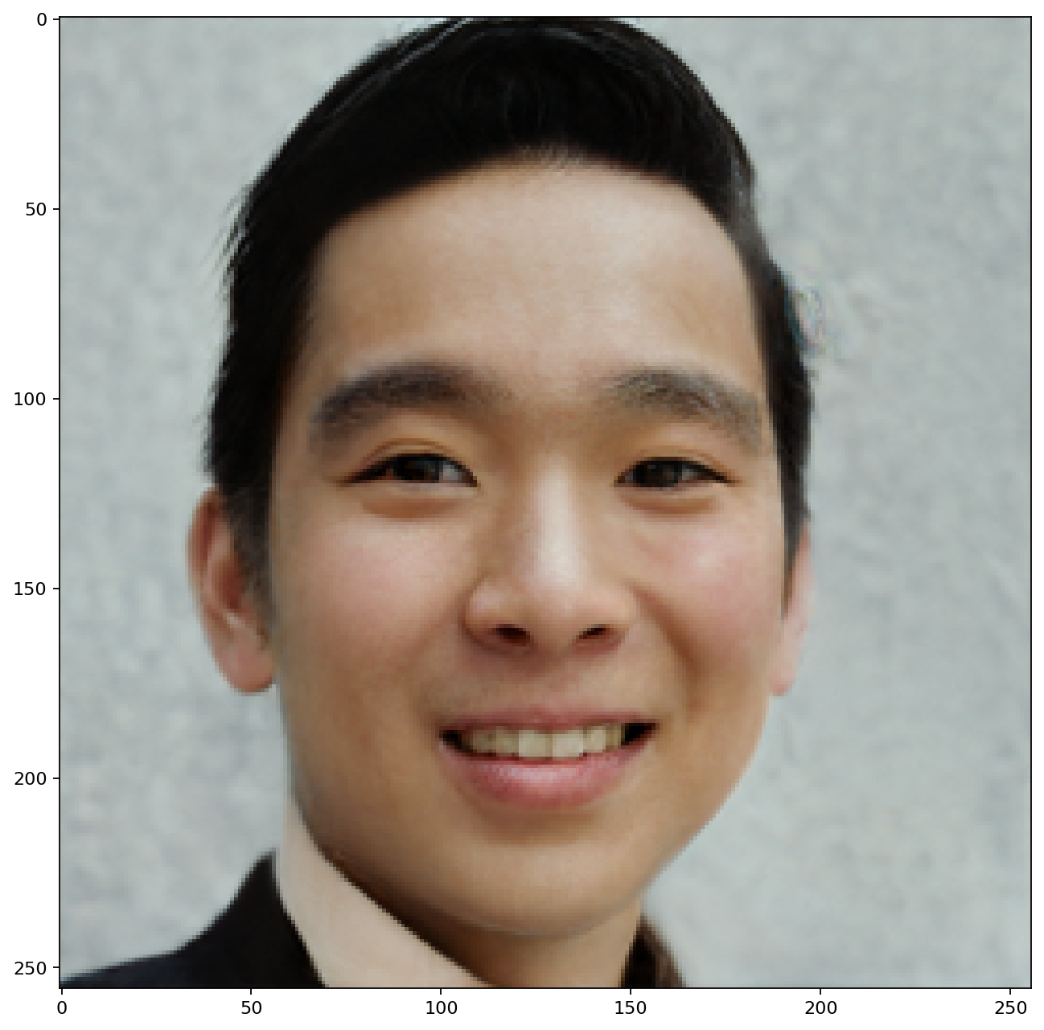
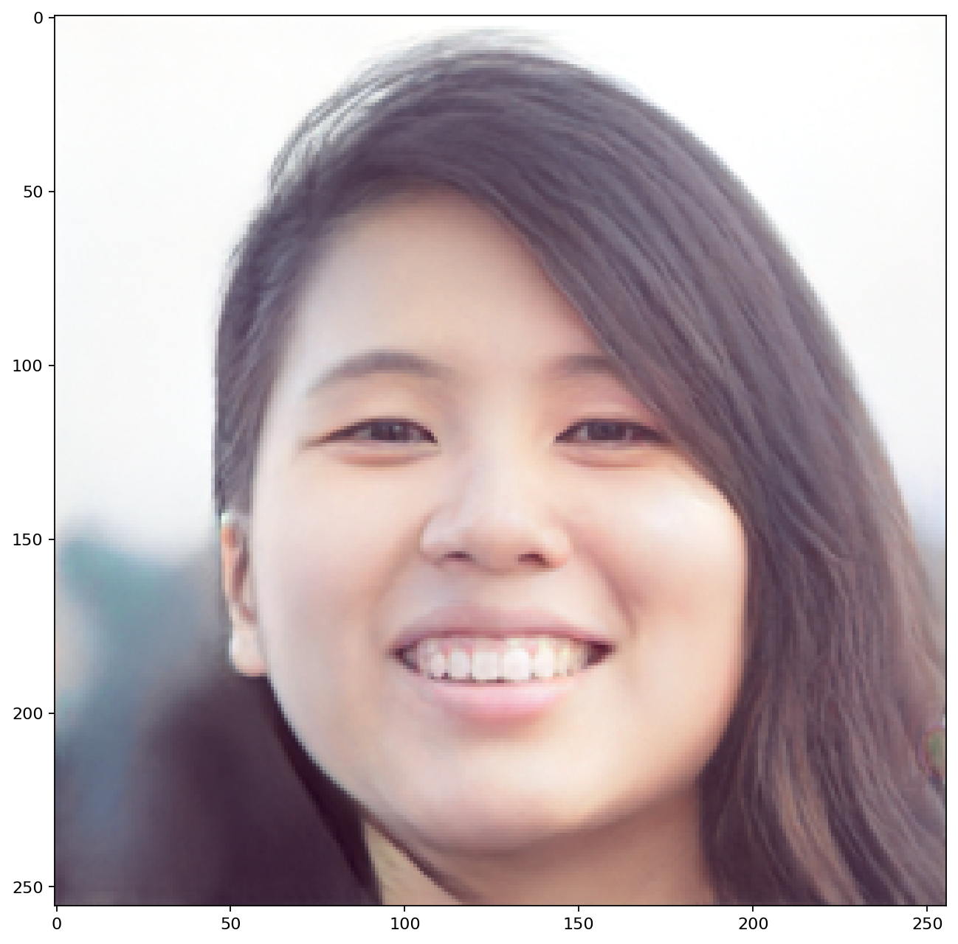
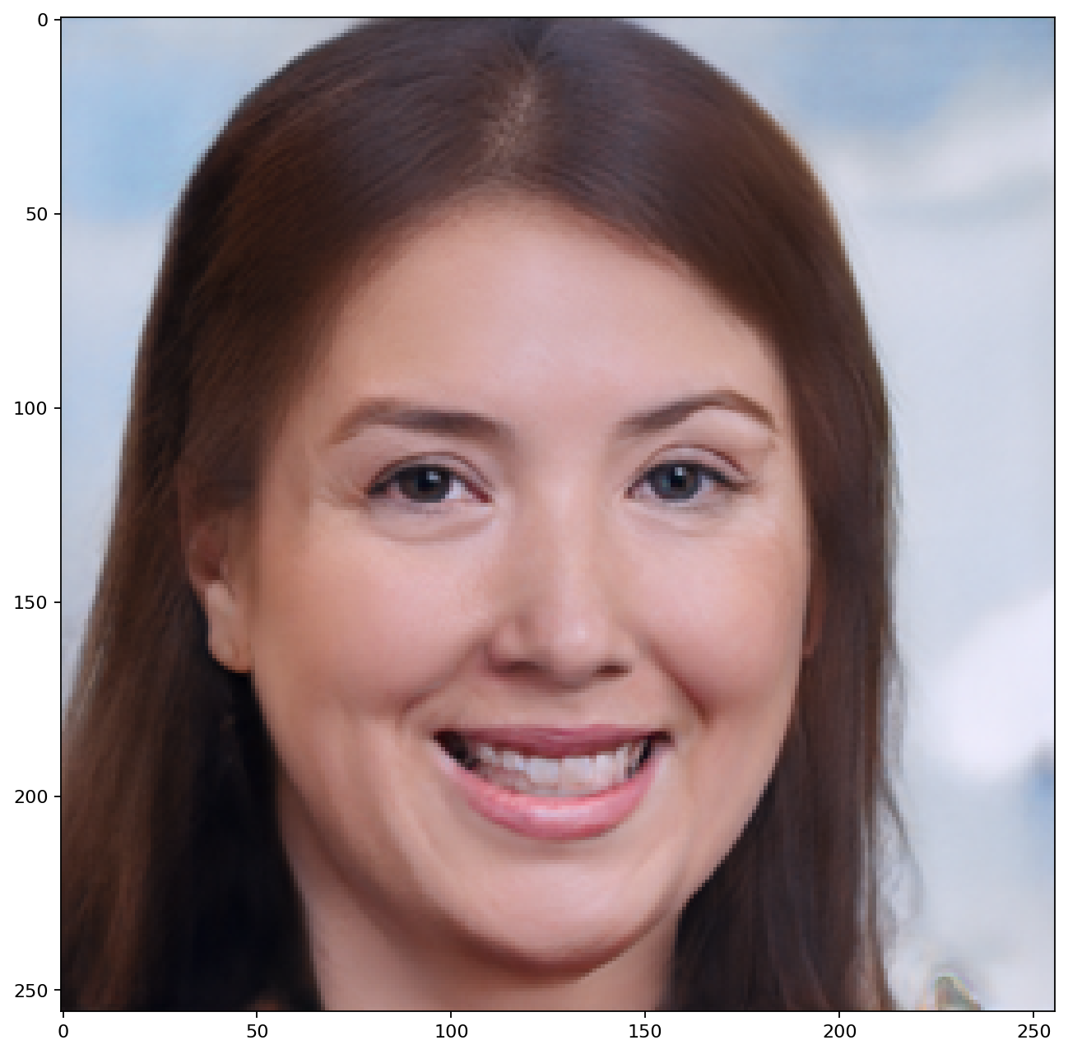
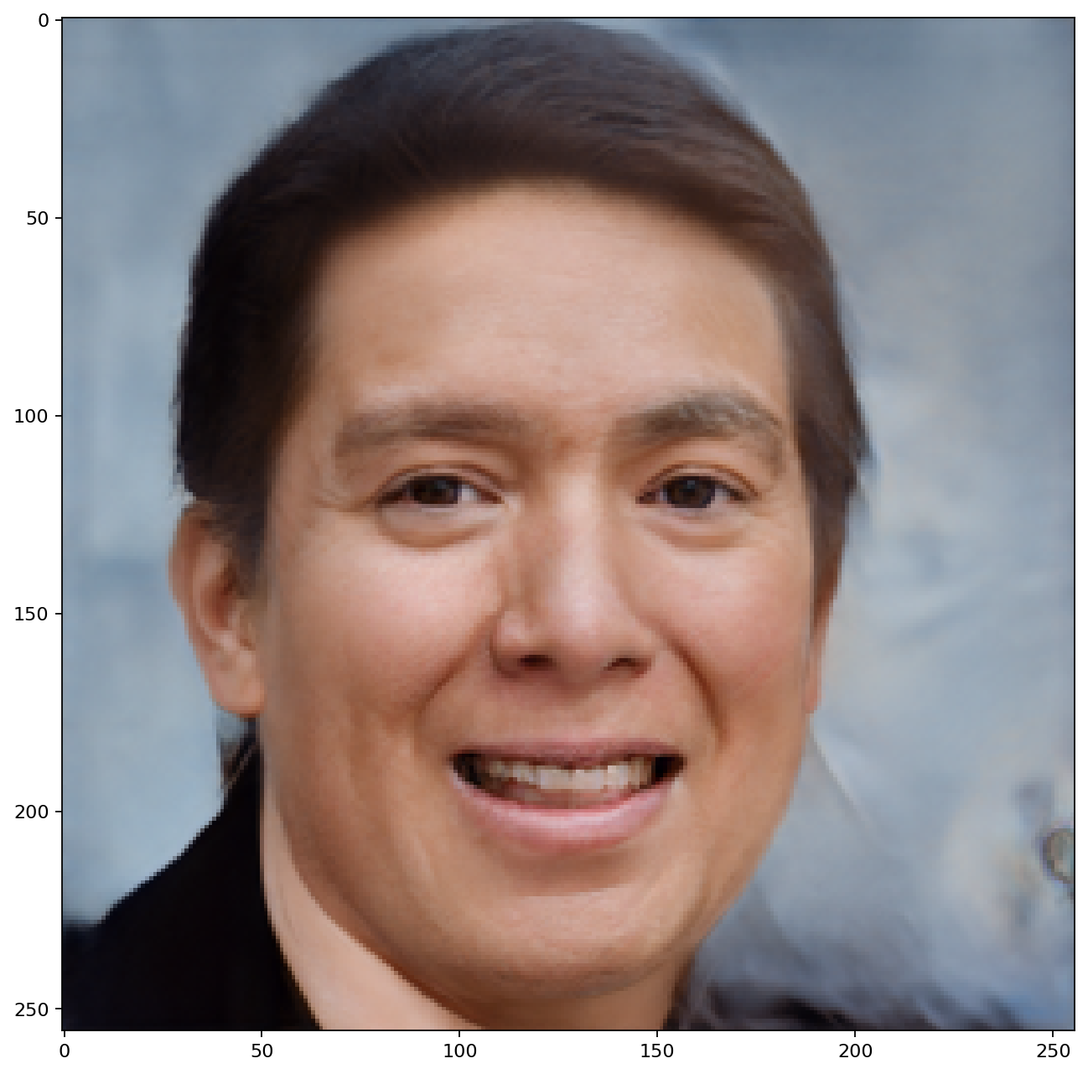
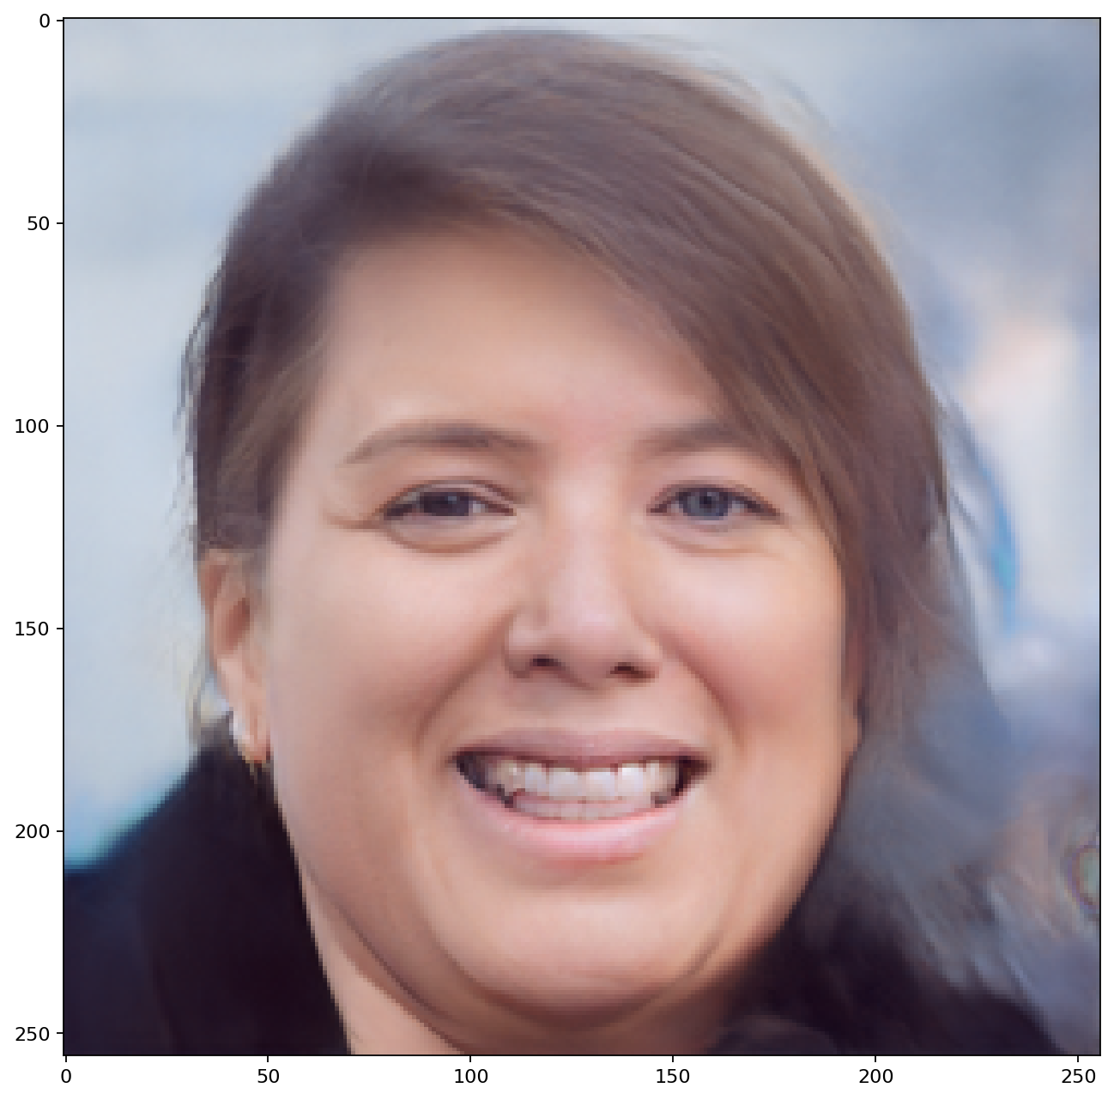
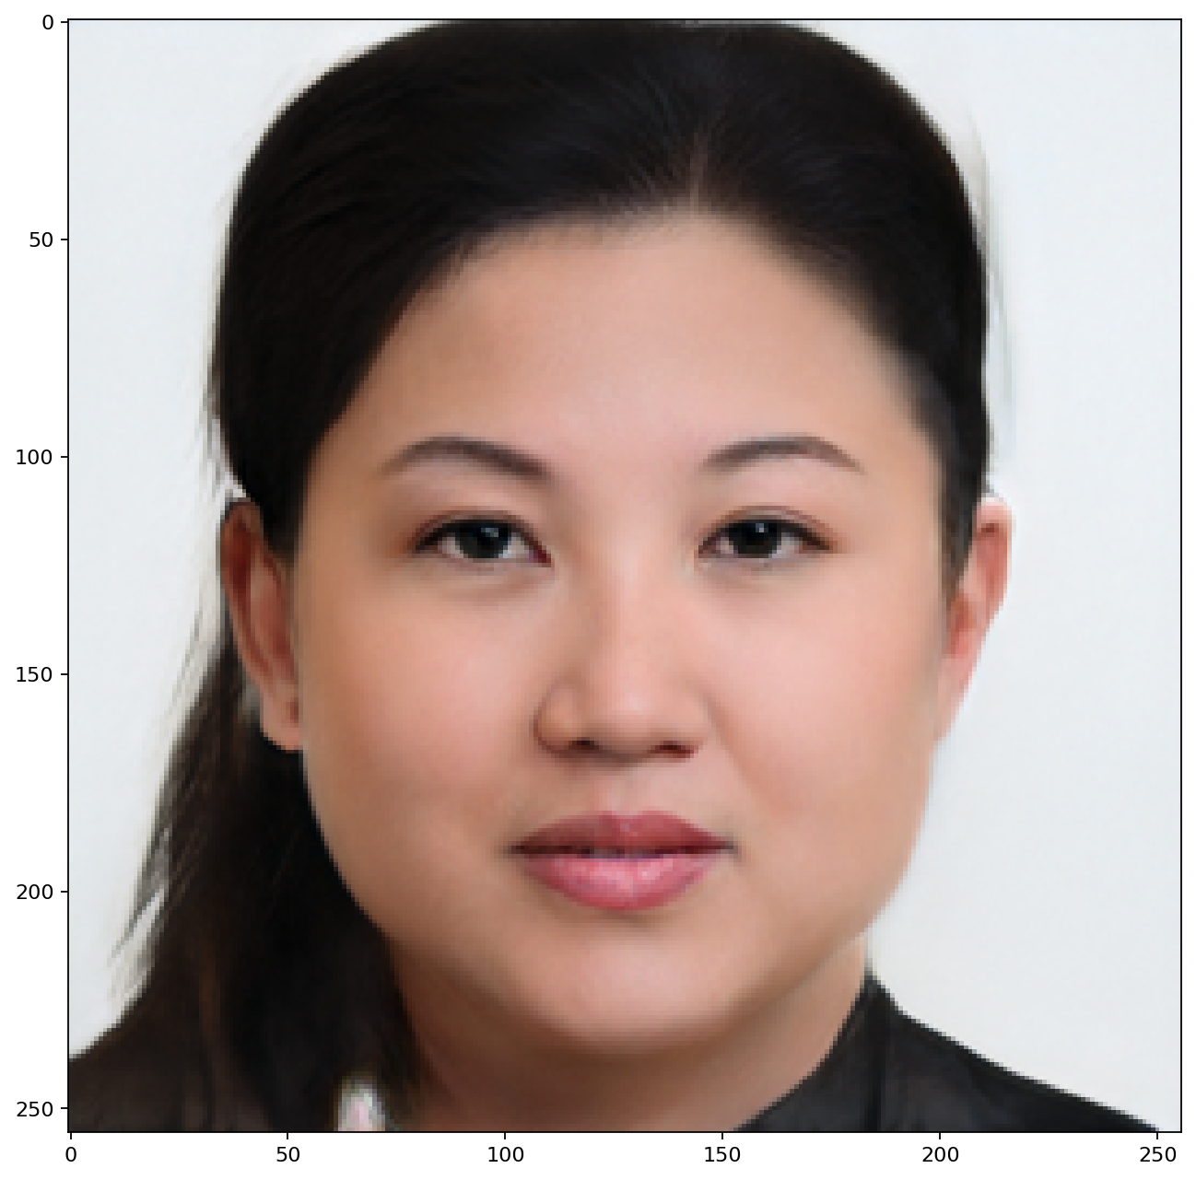
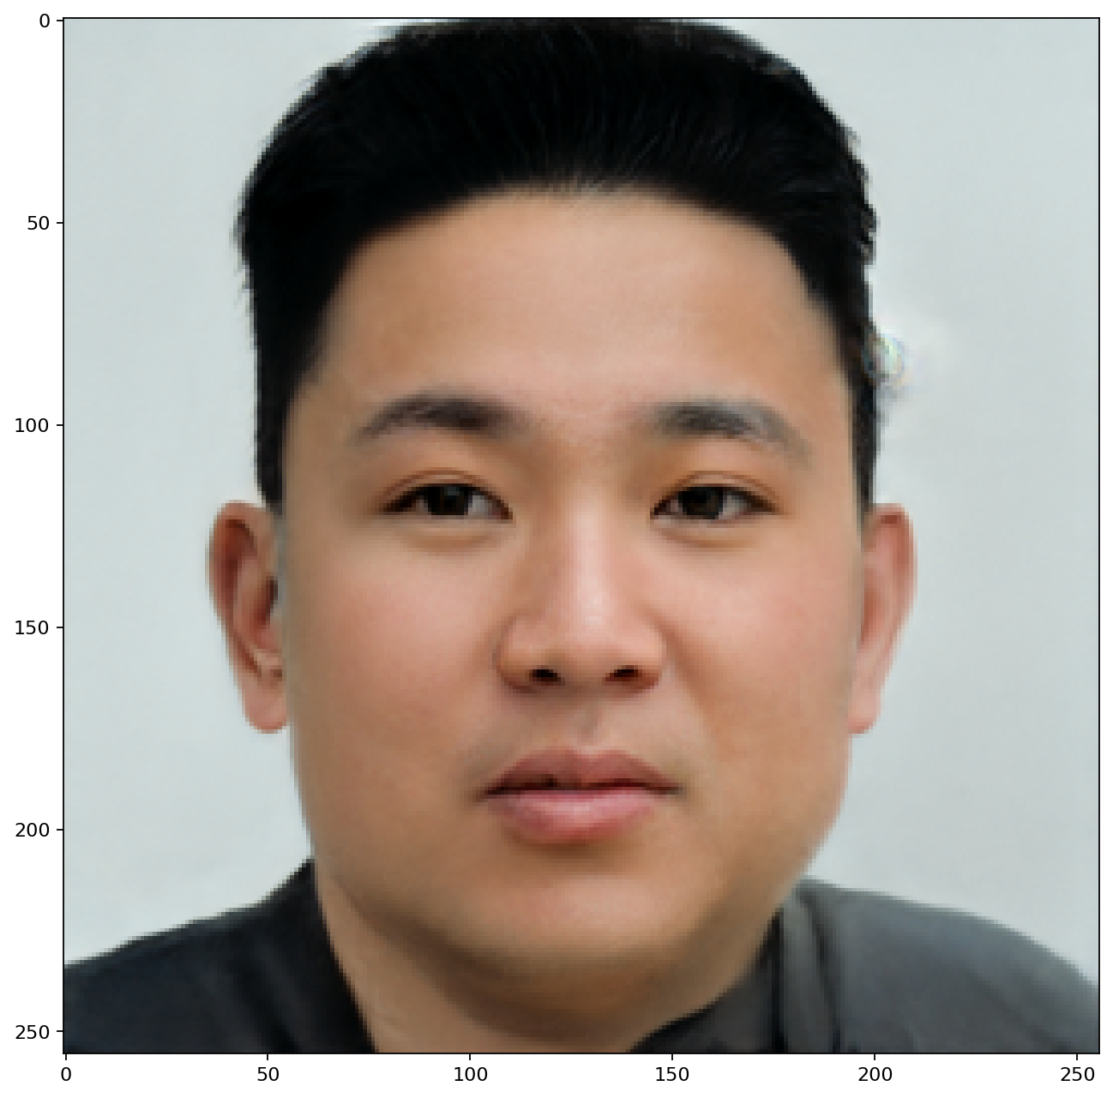
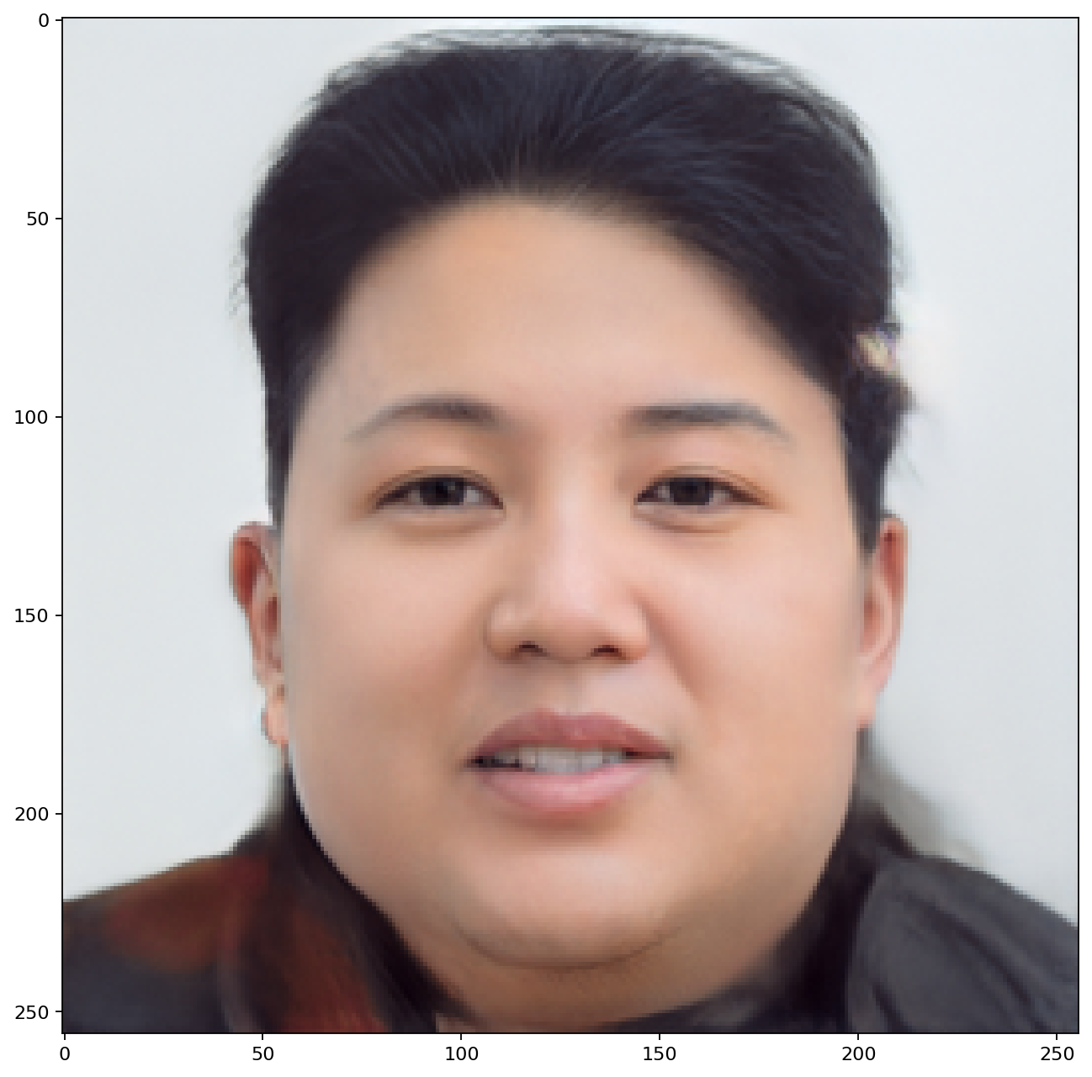
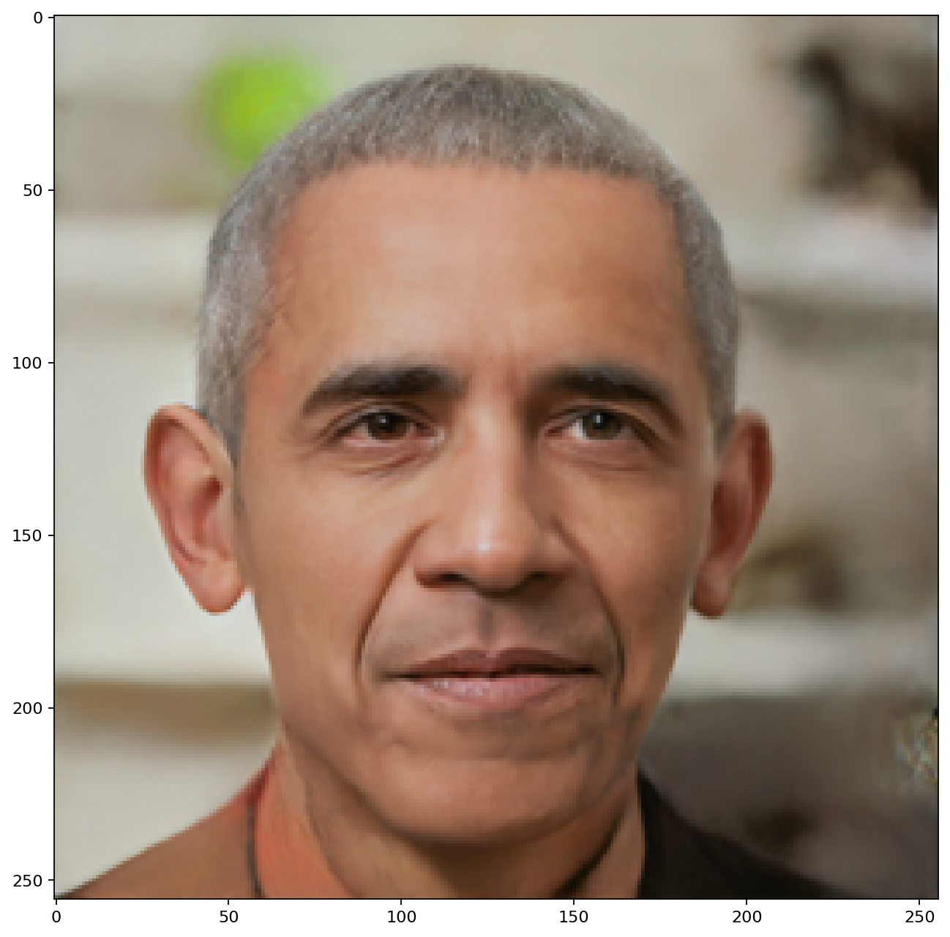
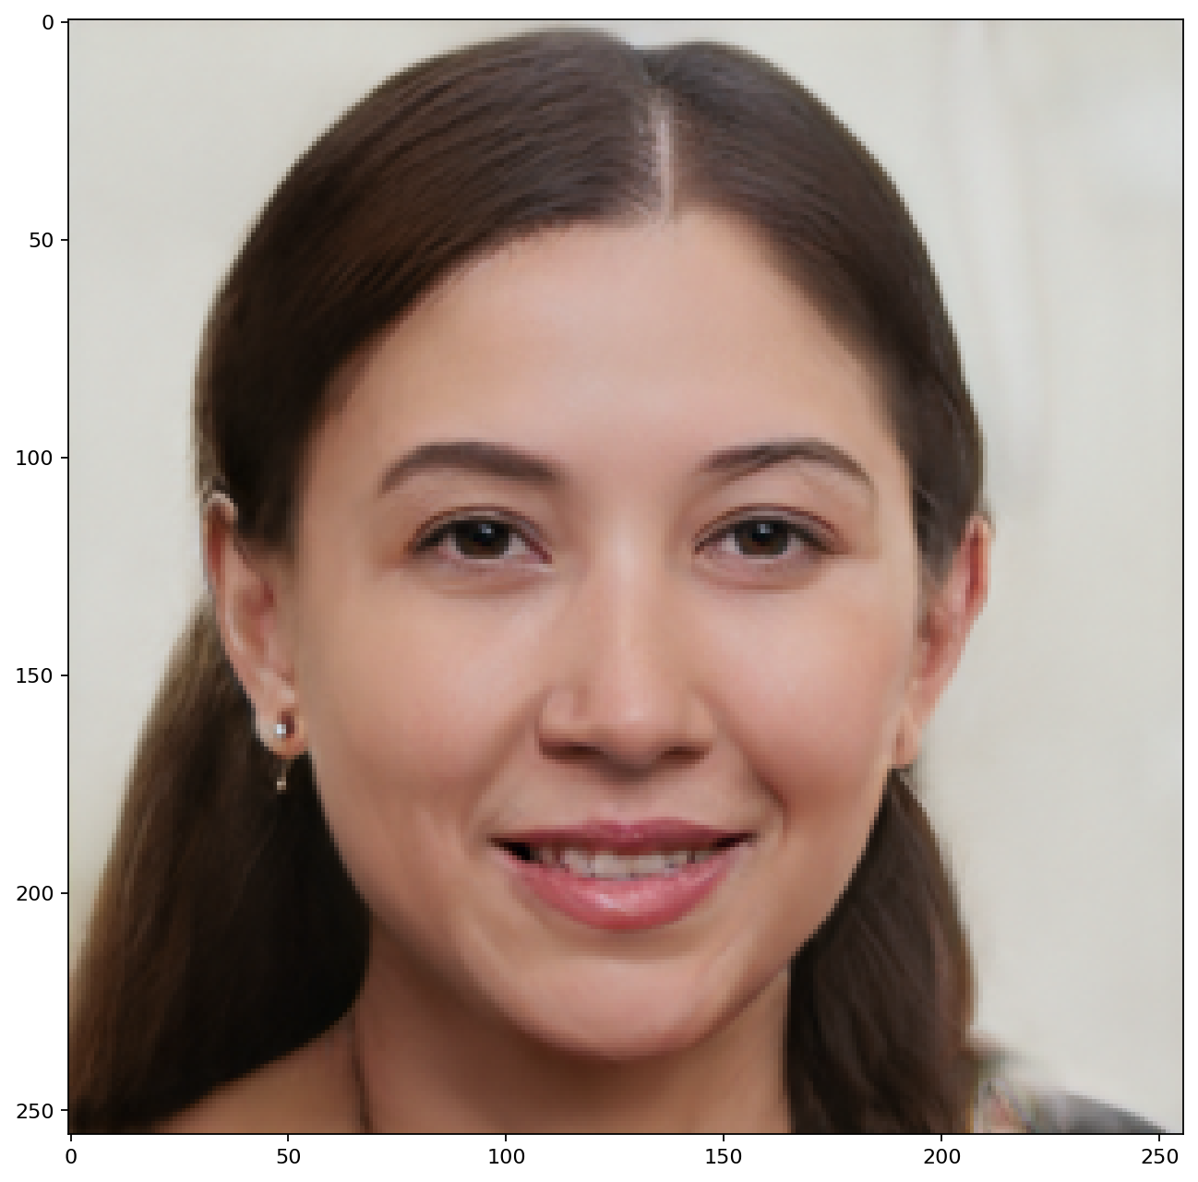
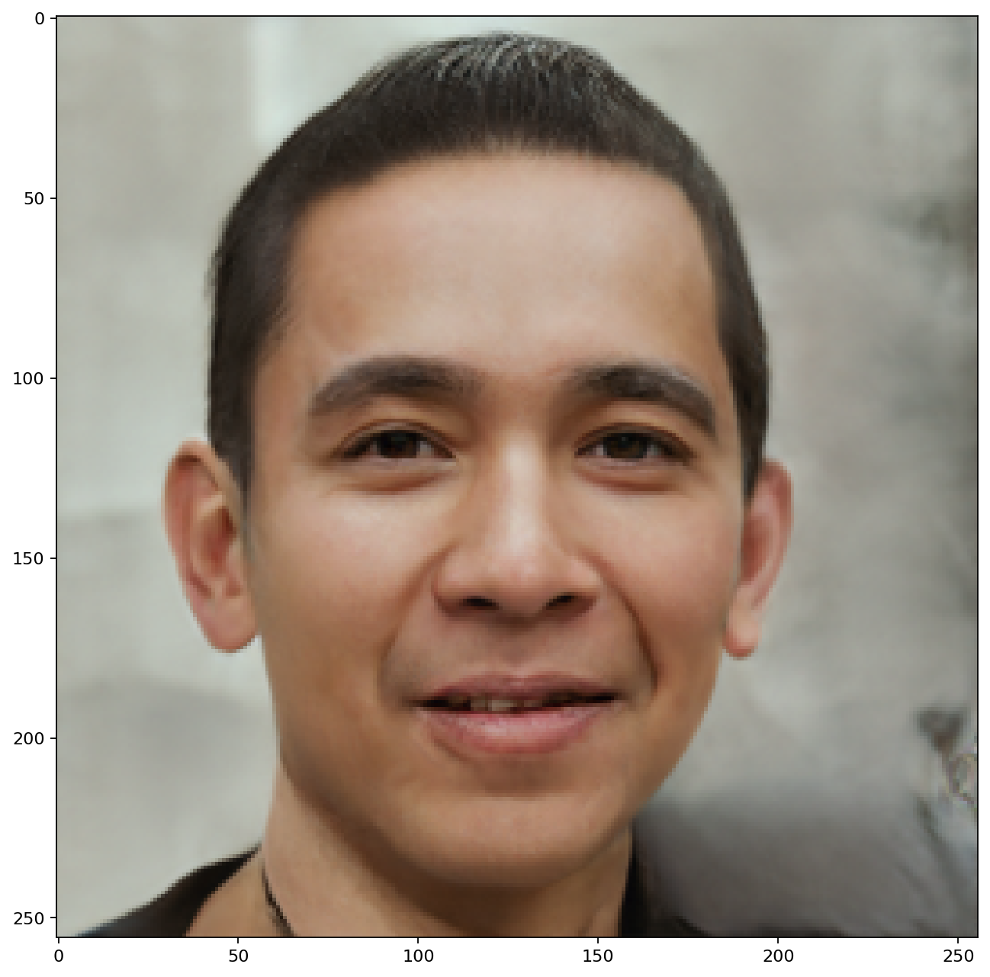
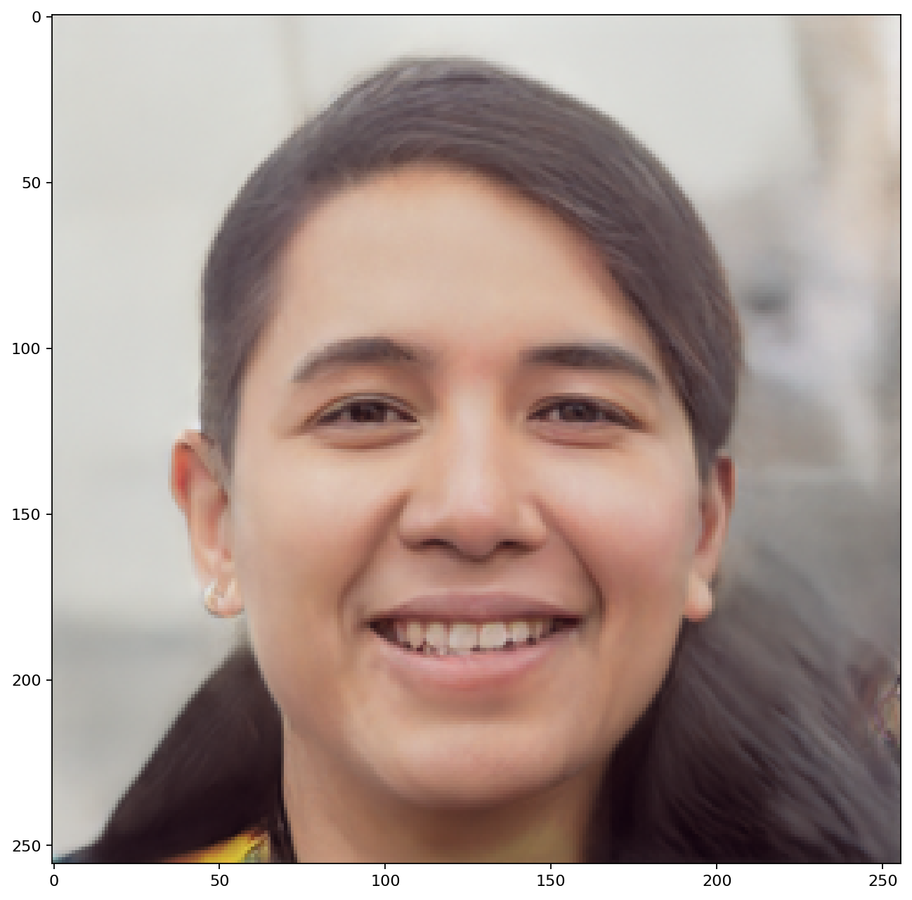
Examples of StyleGAN
* All images/videos created by us

Slide 8
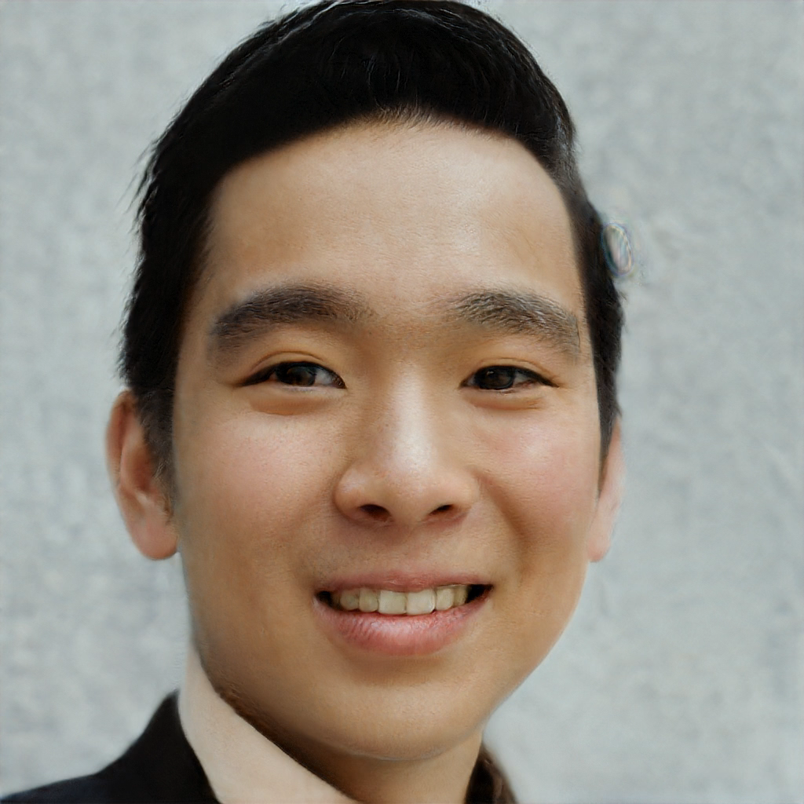
Examples of StyleGAN
* All images/videos created by us

Slide 9
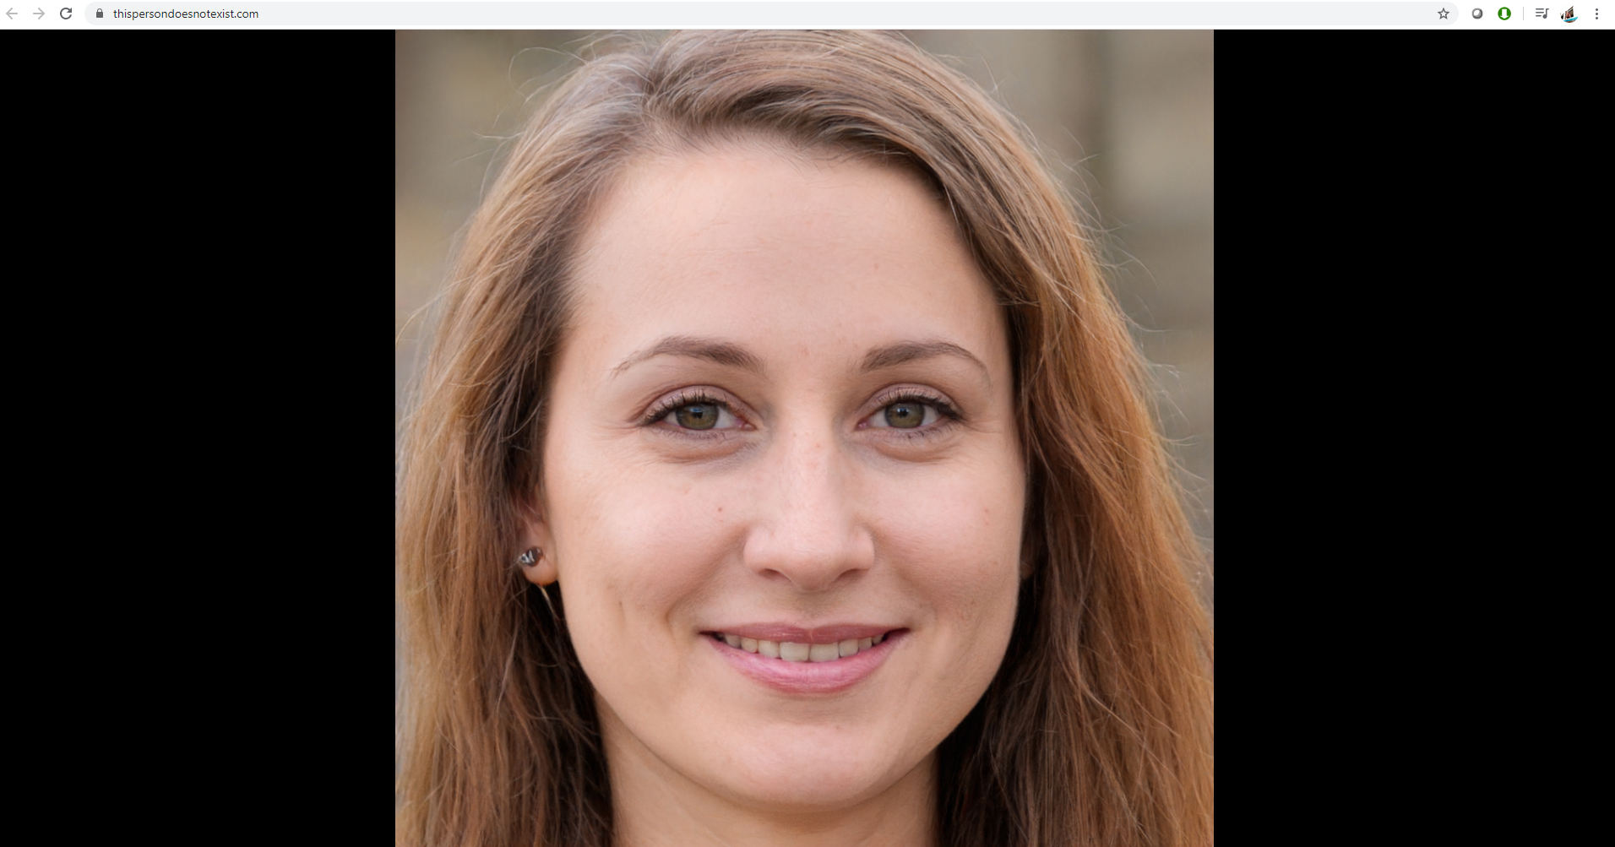
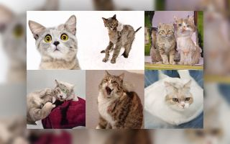
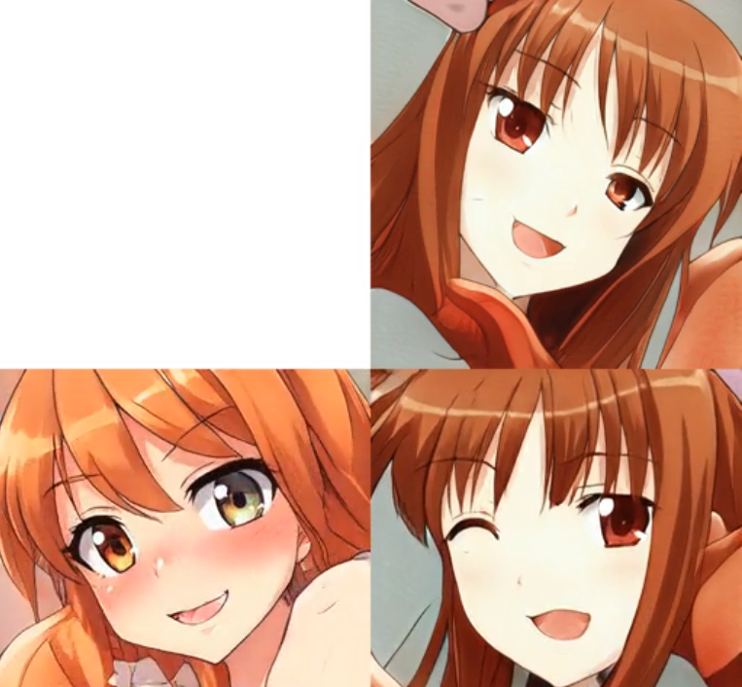
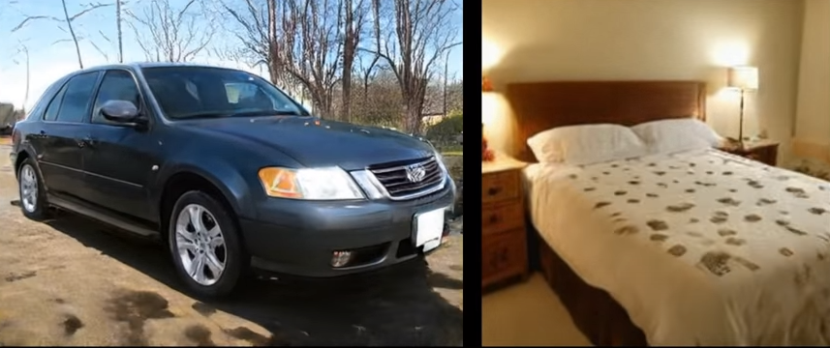
*Other Applications of StyleGAN
Generate human faces
thispersondoesnotexist.com
Generate cats
Generate anime girls???!!!!
Generate rooms
Generate cars

Slide 10
What is StyleGAN?

Slide 11
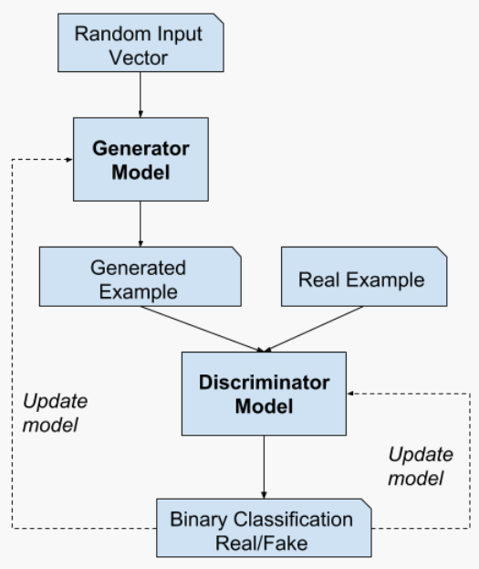
A Quick Recap of GAN, before we go into StyleGAN
Generative Adversarial Networks (GAN) is a machine learning framework for generating images using unsupervised learning. It comprises of 2 neural networks:
→ A generator which learns to generate new samples that imitate an existing dataset
→ A discriminator which learns to distinguish the generator's fake data from real data
The Problem with GAN
While GAN is able to generate high-quality and realistic images, it is limited in its ability to control specific features of the generated image.

Slide 12
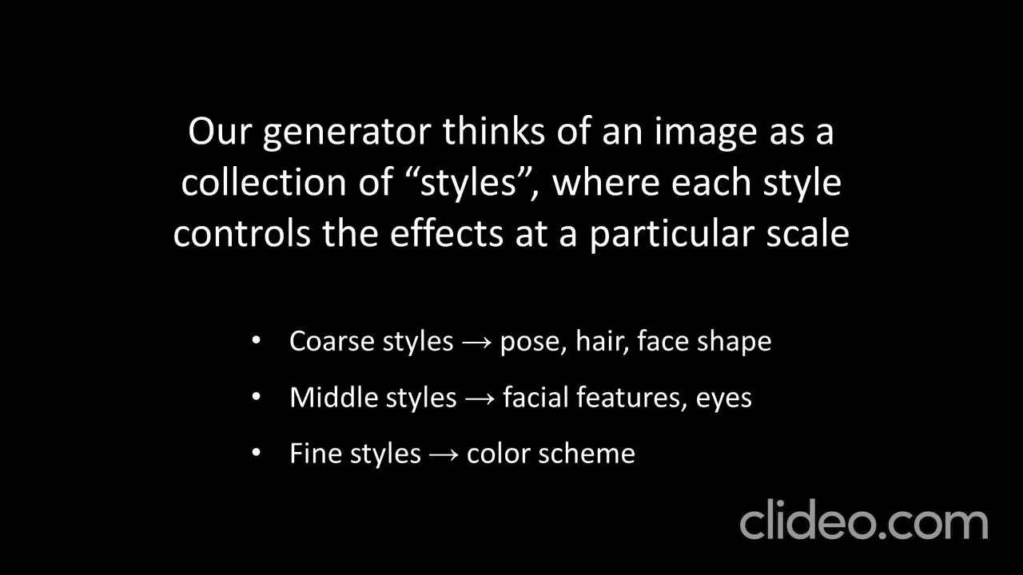
StyleGAN Explained
StyleGAN attempts to tackle the limitation of GAN by adding progressive training to adjust each detail level separately. In doing so, user can control visual features expressed in each detail level in an isolated manner without affecting other levels.
Detail level | Resolution | What is affected?
Coarse | Up to 82 | Pose, general hair style, face shape etc.
Middle | 162 to 322 | Finer facial features, hair style, eyes open/closed etc.
Fine | 642 to 10242 | Color scheme (eye, hair and skin) and micro features.

Slide 13
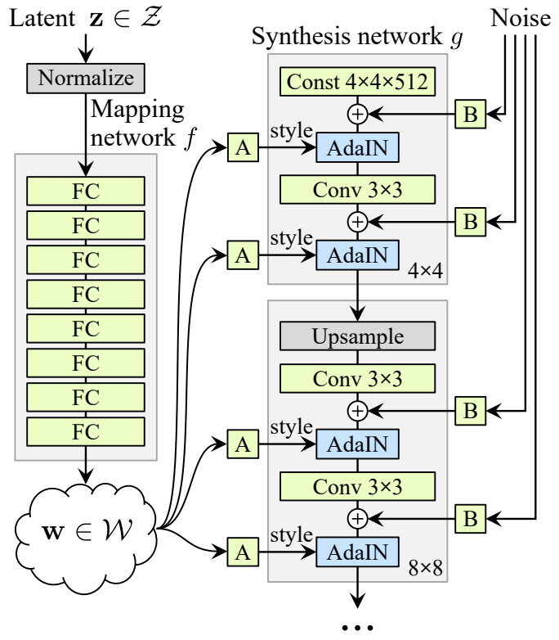
What Is the StyleGAN Model Architecture
StyleGAN is described as a progressive growing GAN architecture with 5 modifications, each of which was added and evaluated incrementally:
Baseline Progressive GAN
Addition of tuning and bilinear up-sampling
Addition of mapping network and AdaIN (styles)
Removal of latent vector input to generator
Addition of noise to each block.
.
.
.
.
Addition of Mixing regularization

Slide 14
StyleGAN Encoder: representing images in latent space
How does it work?
Learn a latent representation of an image from a (pre-trained) StyleGAN generator
Latent directions trained from a predictive classifier using latent space as features
Image transformations
How does the image look like in latent space?
To manipulate the images to e.g. smile
Notes:
What is StyleGAN Encoder?
How does it work

Slide 15
StyleGAN Encoder: Input data
Learn a latent representation of an image from a (pre-trained) StyleGAN generator
Latent directions trained from a predictive classifier using latent space as features
A handful of labelled attributes e.g. is the image smiling? Gender? Age?
Image
Pre-trained StyleGAN generator
Image
Notes:
What is StyleGAN Encoder?
How does it work

Slide 16

Web Showcase of StyleGAN

Slide 17
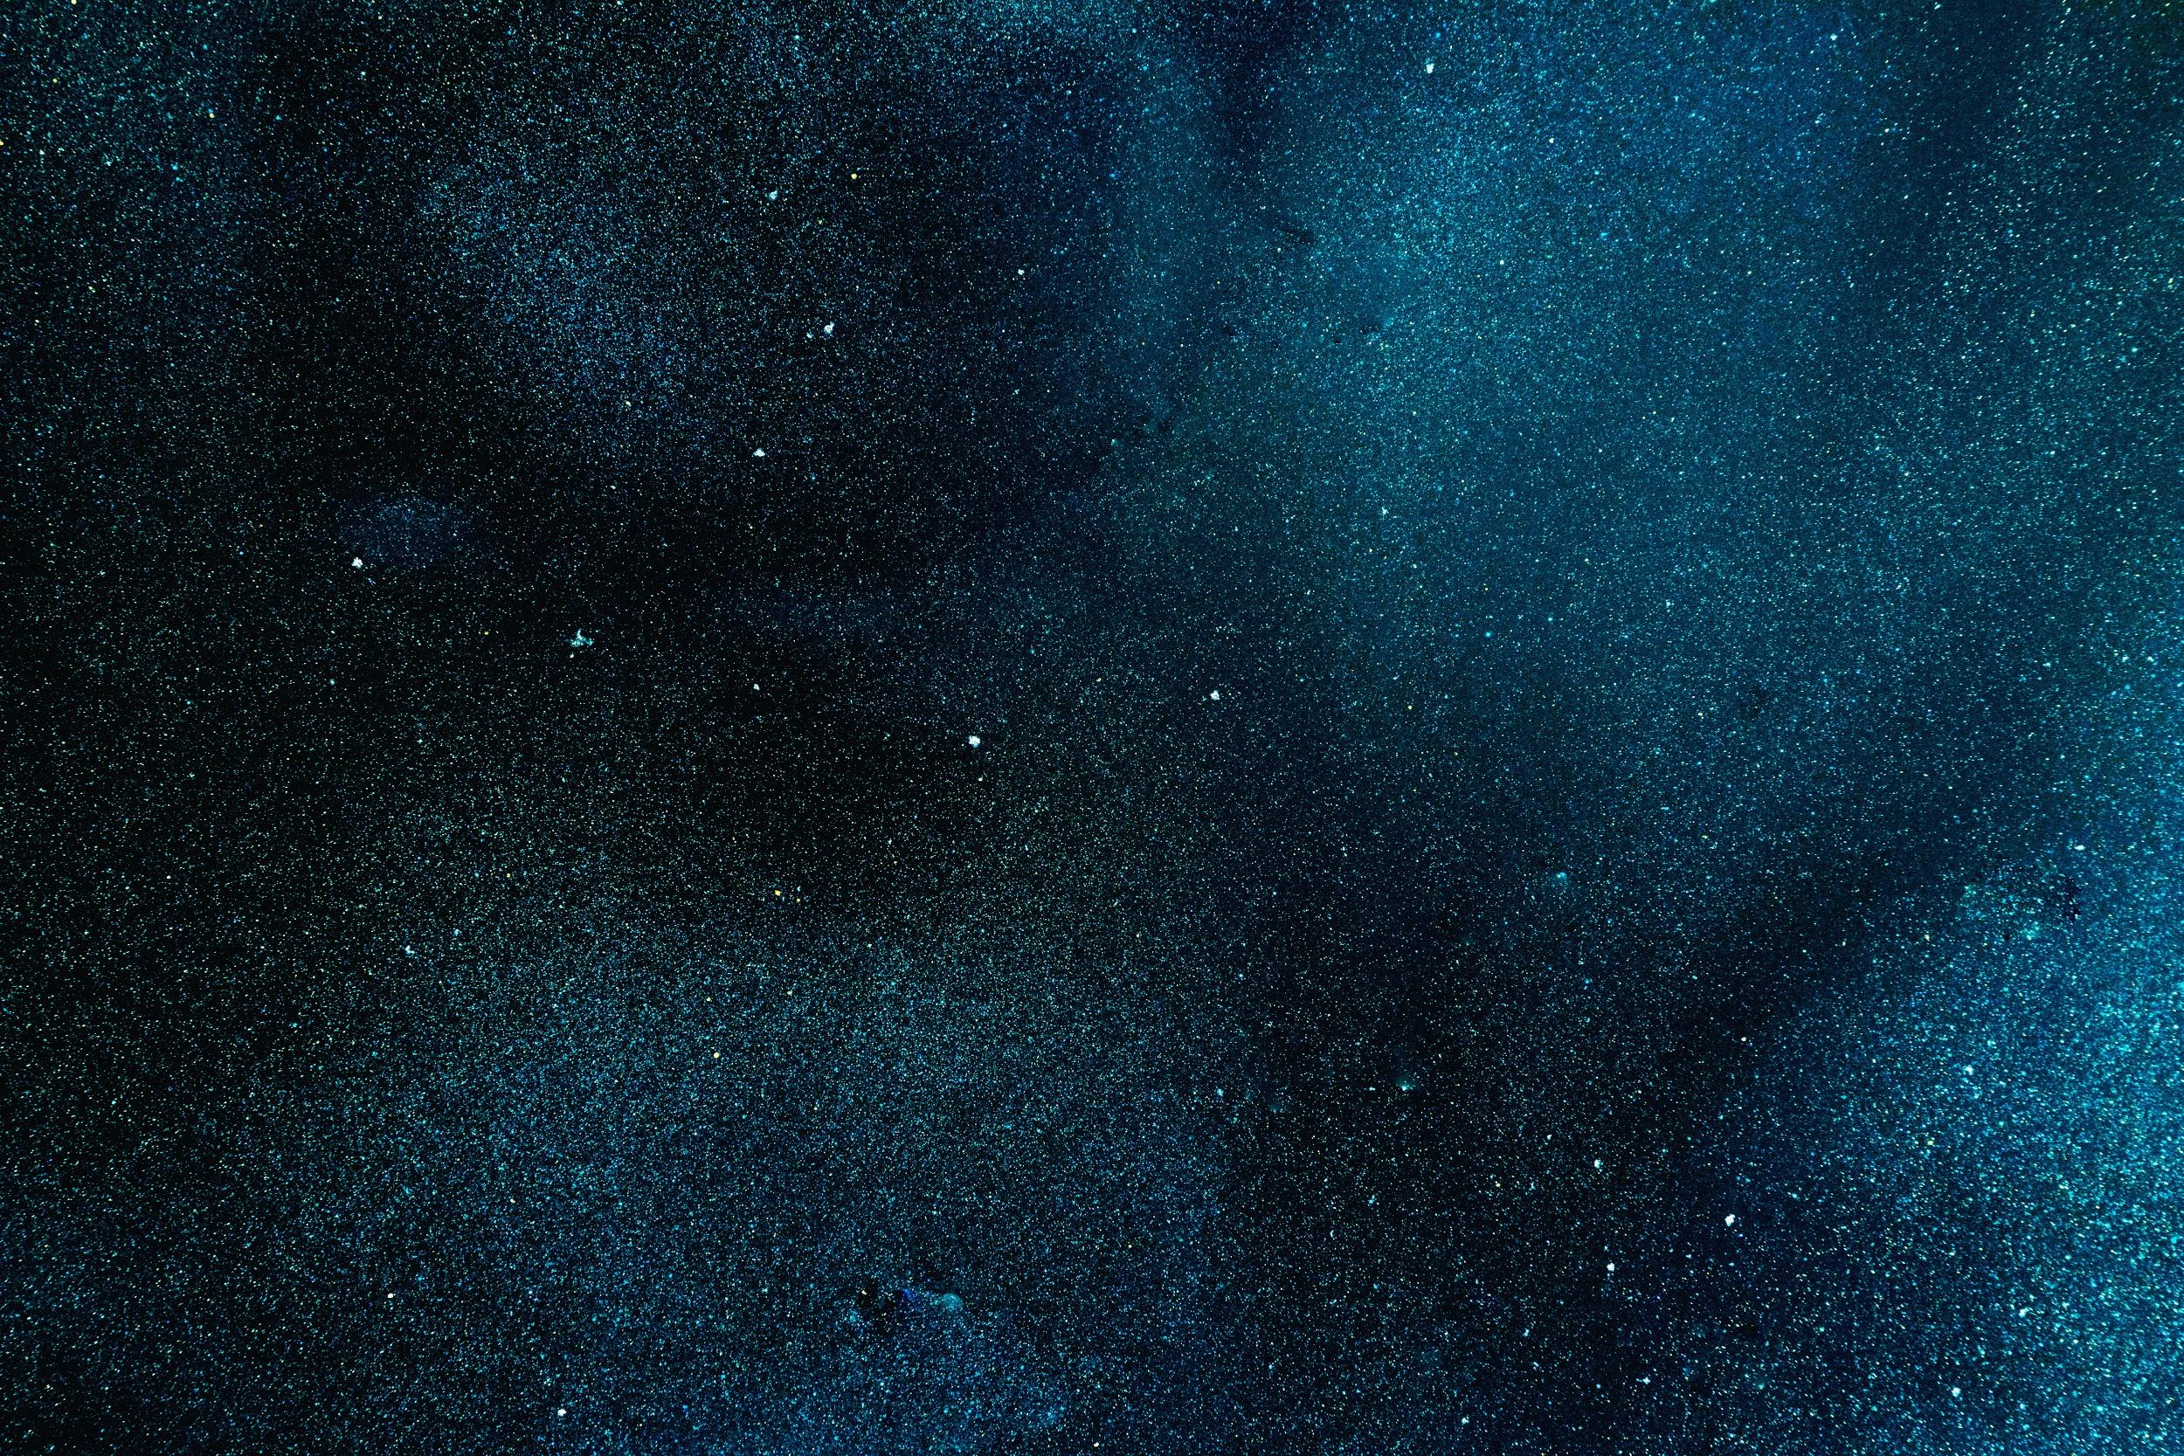
Demo Time

Slide 18
Challenges & Limitations

Slide 19
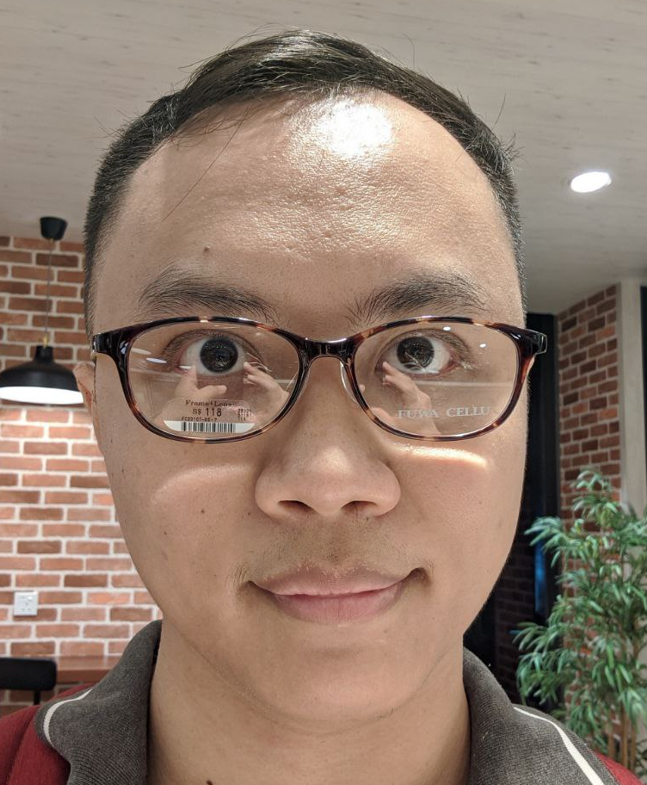
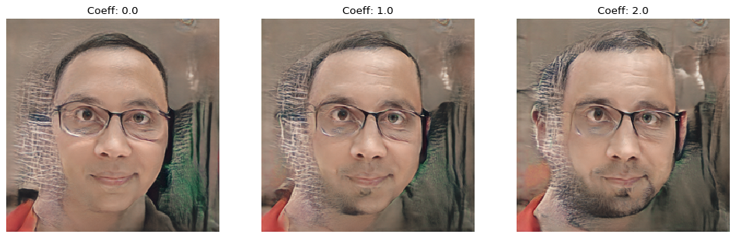
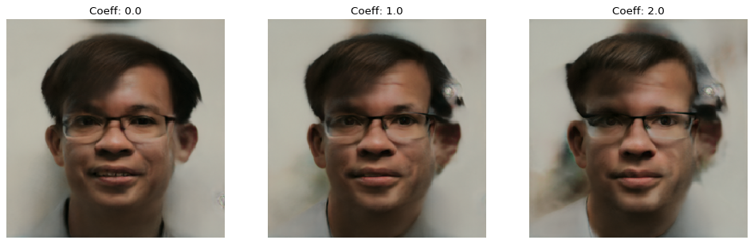
Limitation of StyleGan: Issues with low resolution

Slide 20
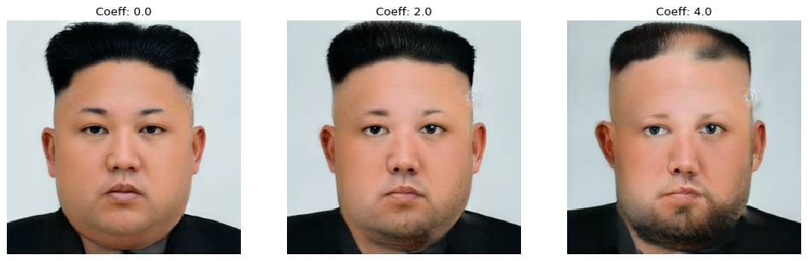
Limitation of StyleGan: Image quality
Water droplets like distortions observed in StyleGAN images – caused by generator intentionally creates this to ‘sneak’ past instance normalization
Facial points detection in StyleGAN can be improved: Lower left chin not detected by the model
Analyzing and Improving the Image Quality of StyleGAN: https://arxiv.org/pdf/1912.04958.pdf

Slide 21
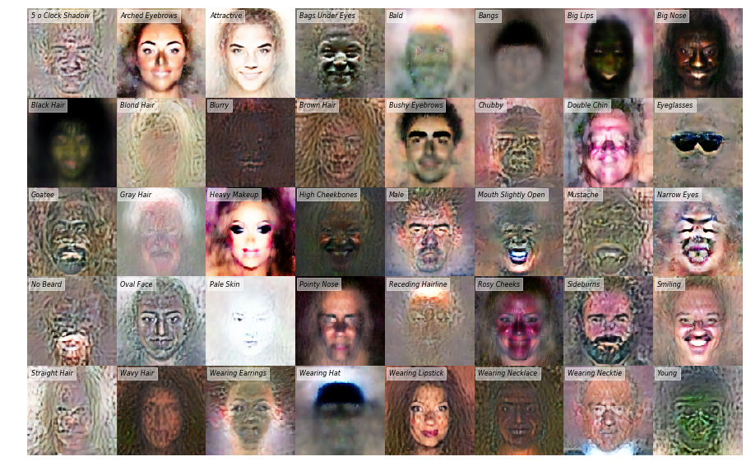
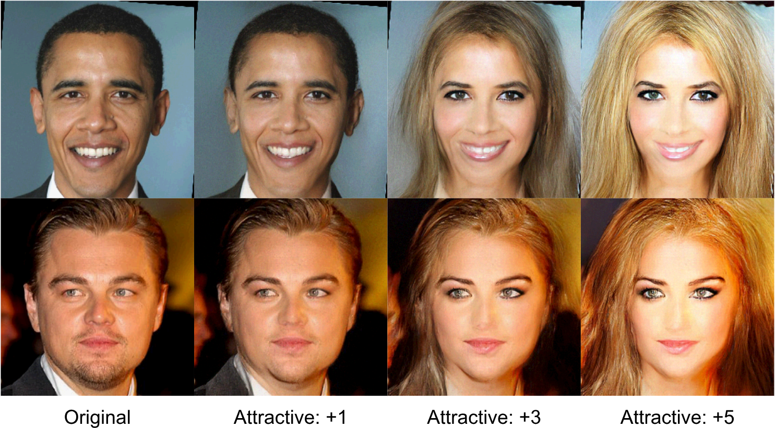
Limitation of StyleGan: Inherent biasness ;
Attractive
Big lips and Big nose
Inherent biasness are encoded in the latent representations
Certain level of correlations between features are encoded in the model
Attribute vectors
Images from:
Generative adversarial interpolative autoencoding: adversarial training on latent space interpolations encourages convex latent distributions: https://arxiv.org/pdf/1807.06650.pdf,
Covering up bias in CelebA-like datasets with Markov blankets: A post-hoc cure for attribute prior avoidance https://arxiv.org/pdf/1907.12917.pdf
As attractiveness increases, image loses its original profile and converges to an image that depicts female, white and blonde
Notes:
https://arxiv.org/pdf/1707.05776.pdf

Slide 22
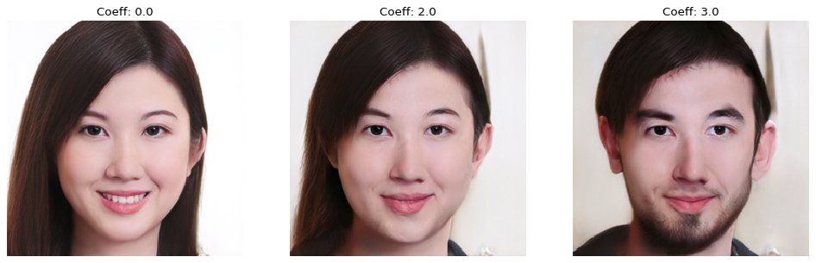
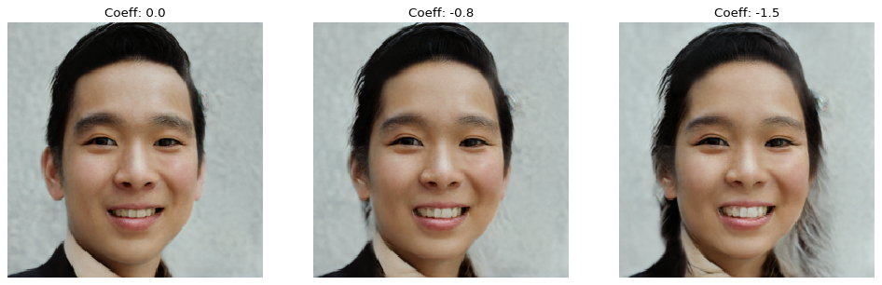
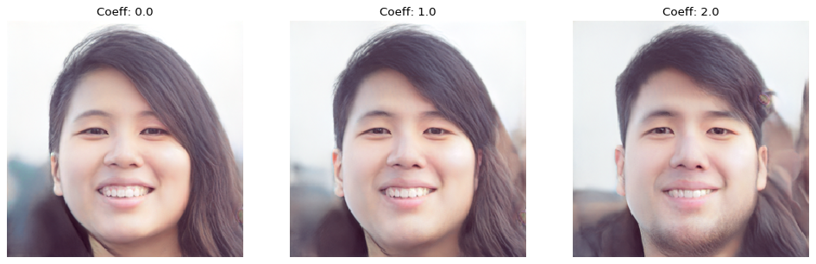
Questions?

